Slide 1
DEPARTMENT OF COMPUTER SCIENCE AND ENGINEERING​
EARLY PREDICTION OF CHRONIC KIDNEY DISEASE USING MACHINE LEARNING
P Feerdosh Khan 21KP1A0585

Slide 2
INDEX
Abstract
Objective of project
Problem Statement
Scope & Motivation
Introduction
Literature survey
Existing Method
Disadvantages
Proposed method
Advantages
Project Flow
Hardware and Software Requirements
Architecture
Module
Output Screens
Conclusion
Future Work
References

Slide 3
ABSTRACT
Early Prediction of Chronic Kidney Disease Using Machine Learning
Chronic Kidney Disease (CKD) often goes undetected until its later stages, making early diagnosis critical for effective treatment.
This project applies machine learning algorithms to predict CKD at an early stage using patient medical data.
Clinical features like blood pressure, serum creatinine, GFR, and more are analyzed from a CKD dataset.
The data undergoes preprocessing steps including missing value handling, normalization, and encoding.
Models like Random Forest, SVM, Decision Tree, and Logistic Regression are trained and evaluated.
Performance is measured using accuracy, precision, recall, F1-score, and ROC-AUC.
Results show that ML models can accurately predict CKD early, helping doctors make informed decisions and improve patient outcomes.

Slide 4
OBJECTIVE OF PROJECT
To develop a machine learning-based system for early detection of Chronic Kidney Disease (CKD).
To analyze clinical and physiological data to identify key indicators of CKD.
To apply and compare different machine learning algorithms for accurate prediction.
To assist healthcare professionals in early diagnosis and timely treatment decisions.
To reduce CKD progression through data-driven risk assessment and proactive intervention.

Slide 5
PROBLEM STATEMENT
Chronic Kidney Disease (CKD) is a major global health issue that often remains undiagnosed until it reaches an advanced stage, leading to serious complications or even kidney failure.
Traditional diagnostic methods rely heavily on clinical judgment and can miss early signs due to the disease’s silent progression.
There is a need for an accurate, automated, and early detection system that can assist healthcare professionals in identifying CKD at its onset using available medical data.
Leveraging machine learning can provide a reliable solution to predict CKD early and improve patient outcomes through timely medical intervention.

Slide 6
INTRODUCTION
With the rise of electronic health records and medical datasets, machine learning (ML) offers powerful tools for disease prediction and decision support.
Chronic Kidney Disease (CKD) is a long-term condition where the kidneys gradually lose their function.
It affects millions of people worldwide and often goes unnoticed in early stages due to mild or no symptoms.
Early detection is crucial to slow disease progression and prevent complications like kidney failure.
This project aims to build an ML-based predictive model that can analyze patient data and identify CKD at an early stage, enabling timely treatment and better patient care.

Slide 7
LITERATURE SURVEY
S.NO | TITLE | AUTHORS | DESCRIPTION | DRAWBACKS
1 | A Survey of Machine Learning Techniques for Chronic Kidney Disease Prediction | Gupta, A., & Kumar, V. | This paper reviews various machine learning algorithms used for predicting chronic kidney disease, highlighting their strengths and limitations in clinical applications. | Limited focus on the practical implementation of models in real-world settings.
2 | Predictive Modeling of Chronic Kidney Disease: A Comprehensive Approach | Khan, M. A., & Ahmad, M. | The study presents a comprehensive framework for predicting CKD using different machine learning techniques, emphasizing feature selection and data preprocessing methods. | The results are based on a limited dataset, which may affect generalizability.
3 | Early Detection of Chronic Kidney Disease Using Data Mining Techniques | Patel, S., & Sinha, P. | This research explores various data mining techniques for early CKD detection, focusing on predictive accuracy and model validation against traditional diagnostic methods. | The study does not address the interpretability of the models for clinical use.

Slide 8
EXISTING SYSTEM
Delayed Results: Requires patients to wait longer for accurate outcomes.
Lower Accuracy: Traditional methods can miss complex health patterns,
leading to less reliable predictions.
Extensive Preprocessing: High dependency on feature selection and data
cleaning, which can exclude important details.
Lacks Real-Time Capability: Limits timely decisions in clinical settings,
delaying critical treatments

Slide 9
DISADVANTAGES
No automation for CKD prediction.
Lack of Proper decision
No proper medication in emergency
Requires more time for the test report
Understanding the test report is difficult for peoples.
Lack of Real Time Prediction

Slide 10
PROPOSED METHOD
🔹 Advanced ML Models: – Random Forest, Gaussian Naive Bayes, Support Vector Machine (SVM) – Improves accuracy for early CKD diagnosis
🔹 Enhanced Data Processing: – Normalization, label encoding, and feature engineering – Ensures high-quality input for model training
🔹 Exploratory Data Analysis (EDA): – Identifies key patterns and correlations in the dataset – Enhances model interpretability and performance
🔹 Real-Time Predictions: – Integrated with a user-friendly Flask interface – Delivers instant, actionable results for clinicians
🔹 Benefits: – Accurate, scalable, and interpretable CKD risk assessment – Supports early intervention and better patient outcomes

Slide 11
ADVANTAGES
Useful to health department to predict the CKD.
Useful for the patients to take better recovery.
We use data science techniques for accurate results.
On click of button output will be generated, no too much time required for CKD prediction.
No need to analyze manually.
Improved Patient Outcomes.

Slide 12
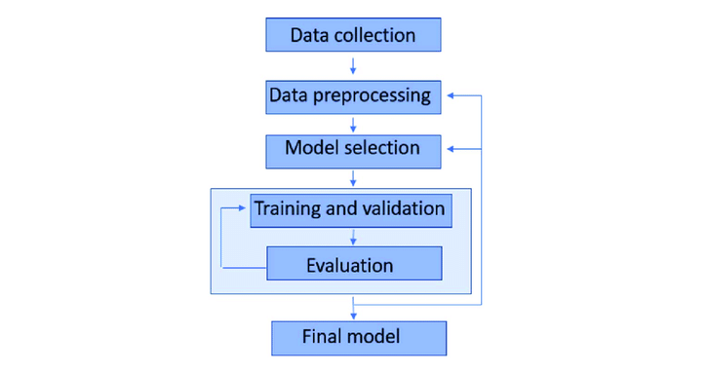
PROJECT FLOW
Figure: Work Flow of Proposed system

Slide 13
HARDWARE & SOFTWARE REQUIREMENTS
Software Requirements
Operating System: Windows 10
Server-Side Scripts: HTML, CSS, Java Script
Programming Language: Python 3.11.4
Libraries: Flask, Pandas, OS, Numpy, Sklearn
Hardware Requirements
Processor: Intel i3 or higher
RAM: 4GB (minimum)
Hard Disk: 128GB
Keyboard: Standard Windows Keyboard
Mouse: Two/Three-Button Mouse
Monitor: Any Compatible Monitor

Slide 14
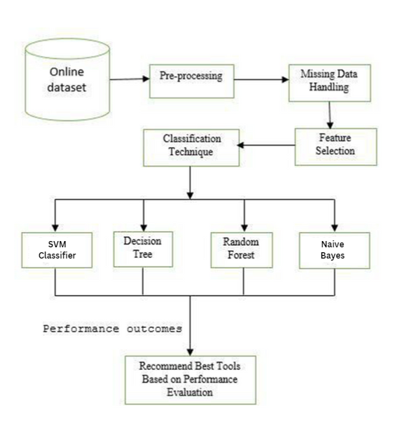
ARCHITECTURE
FIG : ARCHITECTURE

Slide 15
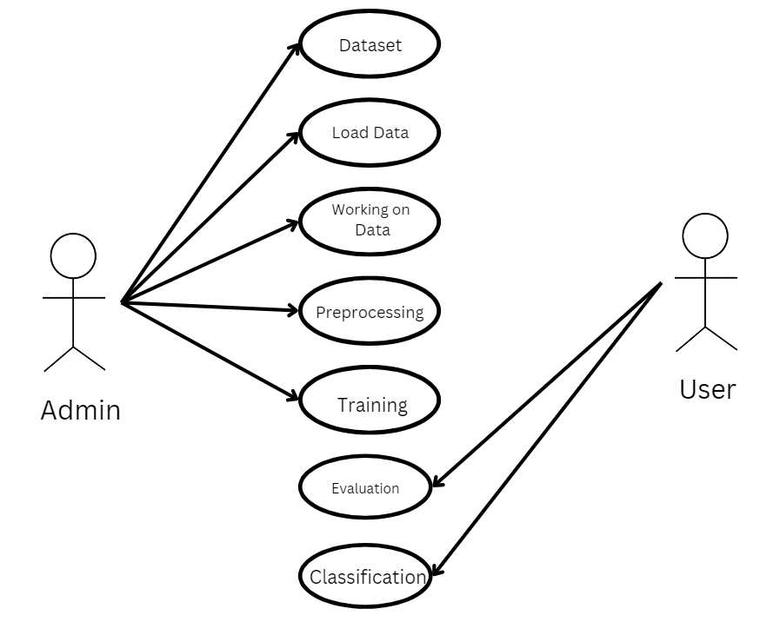
UML DIAGRAMS
USE CASE DIAGRAM
Graphical representation of system functionality
Part of Unified Modeling Language (UML)
Shows system functions and actors goals
FIG : Use Case diagram for interaction between User and System

Slide 16
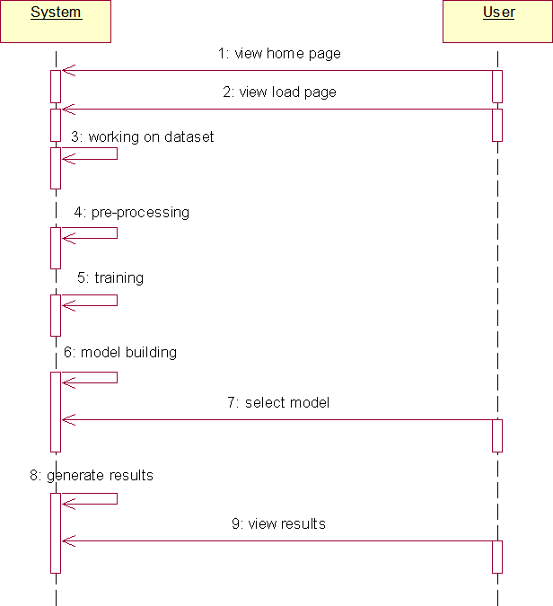
SEQUENCE DIAGRAM
Interaction Flow: Shows the sequence of messages exchanged between objects over time.
Time-Ordered: Messages are displayed in temporal order, from top to bottom.
Lifelines & Activation: Includes object lifelines and activation bars to represent active periods of objects.
FIG : Sequence diagram interaction between User and System

Slide 17
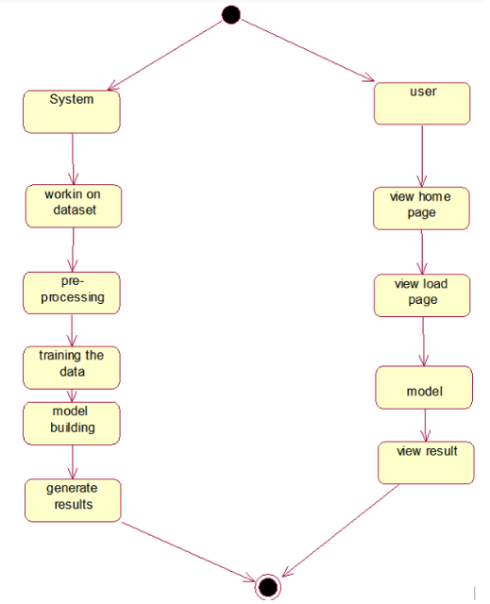
ACTIVITY DIAGRAM
Graphical Representation: Activity diagrams visually represent step-by-step workflows and actions in a system.
Support for Flow Control: They support constructs like choice, iteration, and concurrency to model different control flows.
Business and Operational Workflows: Used to describe business processes and operational workflows of components in a system.
FIG : Activity Diagram between System and User

Slide 18
MODULES: DATA COLLECTION
Objective: Collect comprehensive health and lifestyle data
Key Data: Blood pressure, blood sugar, BMI, age, gender, medical history, lifestyle factors
Sources: EHRs, lab results, patient surveys
Data Quality: Ensures accuracy, completeness, and privacy with validation and anonymization
Purpose: Provides a strong dataset for accurate CKD risk prediction

Slide 19
MODULES: DATA PREPROCESSING
Objective: Prepare data for accurate CKD analysis
Key Steps:
Data Cleaning: Handle missing values, outliers, inconsistencies
Normalization: Standardize data using min-max scaling or z-score
Feature Engineering: Create and transform variables; encode categorical data
EDA: Visualize data distributions and correlations
Outcome: Delivers high-quality, refined data for improved model accuracy

Slide 20
MODULES: MODEL TRAINING
Objective: Develop machine learning algorithms for CKD risk assessment
Algorithms: Random Forest, Gaussian Naive Bayes, Decision Tree, SVM
Process:
Split data into training and testing subsets
Hyperparameter tuning and cross-validation for enhanced accuracy
Metrics: Accuracy, precision, recall, F1-score
Outcome: Reliable models for accurate CKD risk predictions

Slide 21
MODULES: MODEL TESTING
Objective: Ensure accurate predictions and user-friendly access
Model Testing:
Evaluate using reserved testing dataset
Metrics: Accuracy, sensitivity, specificity
User Interface:
Intuitive Flask-based design for healthcare professionals
Input forms for health data; display risk assessment and visualizations
Outcome: Reliable CKD predictions with actionable insights

Slide 22
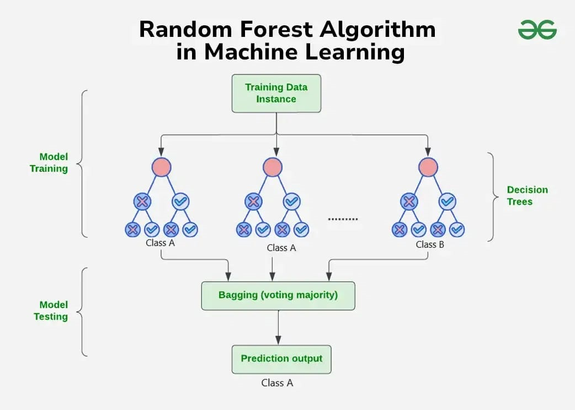
Random Forest
Overview
Random Forest is a powerful ensemble algorithm that
constructs multiple decision trees and merges their results
for better accuracy.
Advantages
High accuracy due to multiple trees reducing
overfitting.
Robust to noisy data and can handle large datasets.
Why Random Forest for CKD?
Effective for complex medical data patterns,
increasing predictive reliability.

Slide 23
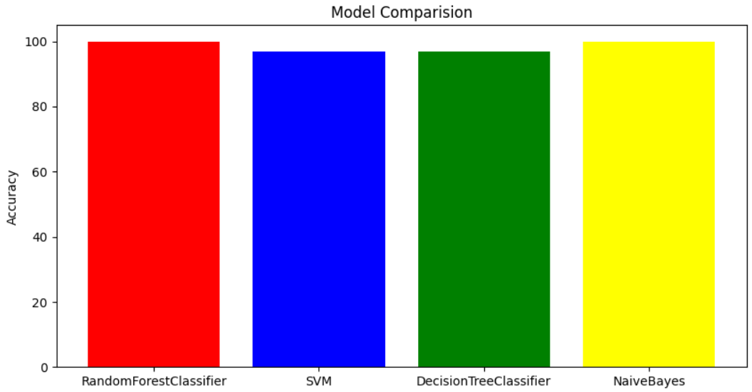
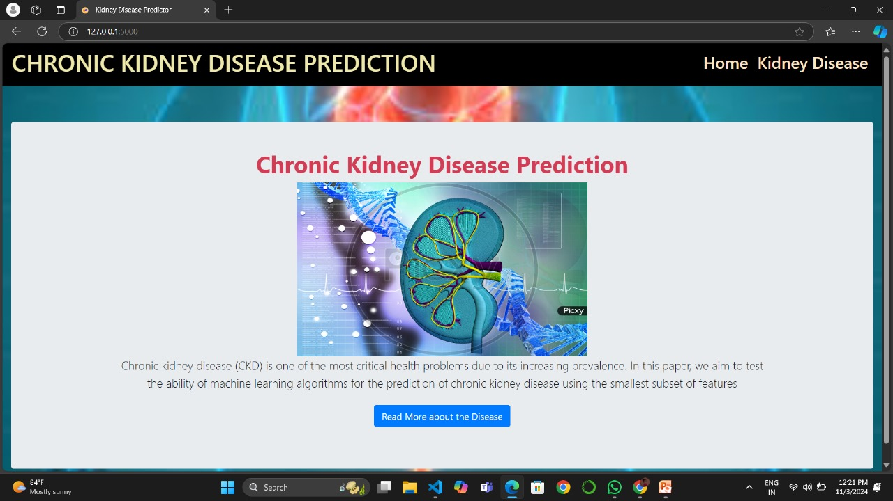
OUTPUT SCREENS
FIG : MODELS COMPARISION
FIG : HOME PAGE

Slide 24
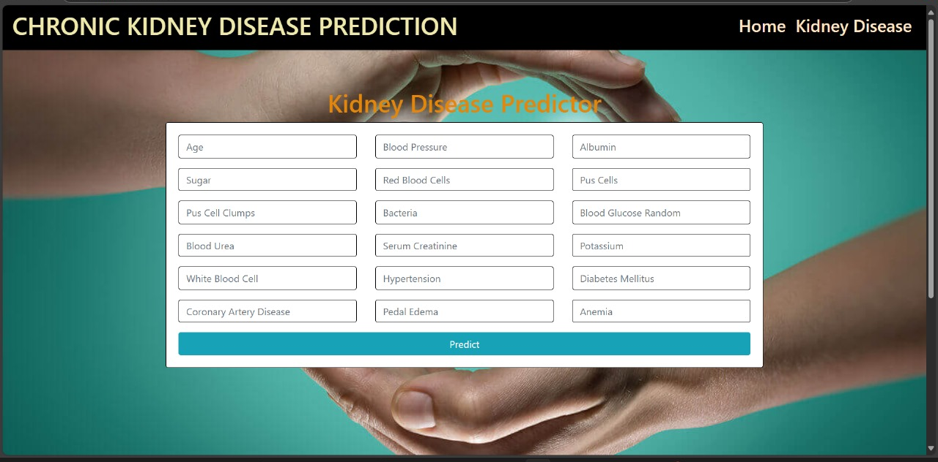


FIG : PREDICTION PAGE
FIG : RESULT PAGES

Slide 25
CONCLUSION
The CKD prediction system utilizes advanced machine learning to enhance early detection and intervention in healthcare.
By integrating effective data collection, preprocessing, and rigorous model training, the system delivers accurate CKD risk predictions based on key health indicators.
Its user-friendly interface empowers healthcare professionals to make informed decisions, ultimately improving patient outcomes.
“This project shows how machine learning can change chronic disease management for the better, leading to a healthier future.”

Slide 26
FUTURE SCOPE
Future enhancements for the CKD prediction system will focus on:
Dataset Expansion: Incorporate diverse patient populations and additional health factors to improve model generalizability.
Advanced Algorithms: Implement deep learning techniques to refine prediction accuracy by capturing complex data patterns.
Feedback Mechanism: Enable the system to learn from new patient outcomes for continuous improvement.
EHR Integration: Explore integration with existing electronic health record systems for streamlined data entry and real-time decision support.

Slide 27
REFERENCES
Gupta, A., & Kumar, V. (2020). A Survey of Machine Learning Techniques for Chronic Kidney Disease Prediction. Journal of King Saud University - Computer and Information Sciences, 32(3), 282-290.
Khan, M. A., & Ahmad, M. (2019). Predictive Modeling of Chronic Kidney Disease: A Comprehensive Approach. Artificial Intelligence in Medicine, 99, 101-111.
Patel, S., & Sinha, P. (2020). Early Detection of Chronic Kidney Disease Using Data Mining Techniques. Journal of Biomedical Informatics, 112, 103612.

Slide 28
THANK YOU

